Slide 1
Analysis Presentation
Group 3E
Fuad Ahmad
Cagatay Kupeli
Sine Mete
Arkın Yılmaz

Slide 2
Functional Requirements
Starting a game; this is a mandatory option for games.
Picking a level; user can pick any level s/he wants before starting the game.
User will be able to control the Jumpman with keyboard by using WASD. Player also use space key to jump and strike with hammer after taking it.
User can change the settings of the game. Available settings are; sound:on/off.
User can see the Credits section in help menu which this page provides names of providers.

Slide 3
Functional Requirements-cont
User will be able to access the help menu. Help menu contains useful information about how to control user and how obstacles work.
User will be able to see high score table which contains different high scores for different levels. If user exceeds any 5 of the high score, player’s high score will be placed upon the high score table.
The game will offer various power-ups and obstacles. These surprises will ease or complicate game.
The game will contain a credits panel.
Player will be able to pause game.

Slide 4
Nonfunctional Requirements
The response time will be low and effective so that enables users to play with minimal delay. The original game is not good at response time.
The design of the game will be simple and understandable.
Game’s graphics will be designed very appealing. There will be no delay in animations or actions. In other words, any actions of the character or moving obstacles will be very smooth.
Game will be user-friendly, which let users to play game easily. As a group, we are focusing to make game as possible user-friendly as possible.

Slide 5
Nonfunctional Requirements-cont
We are also planning to develop game extendible for making it suitable for re-uses and future works.
Modifiability is another important issue that we are planning to accomplish, this way any unwanted parts will be easily modified.
There will be no problem about availability. Users will be able to use our game any time after installation.

Slide 6
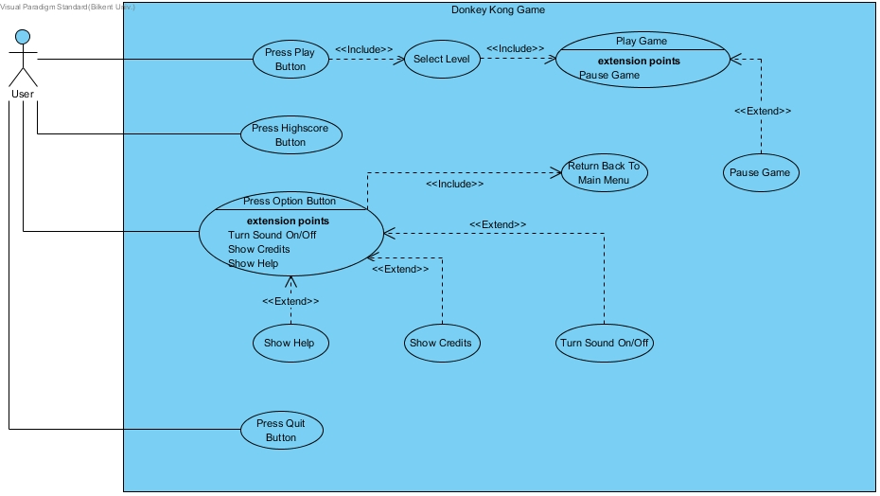
Use Case

Slide 7
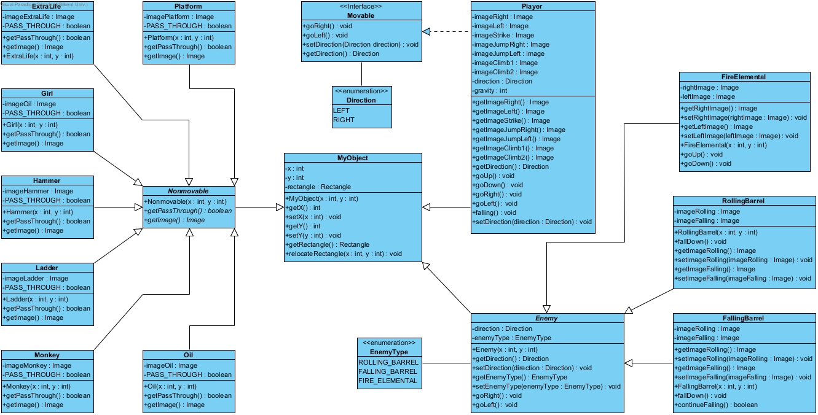
Class Diagrams

Slide 8
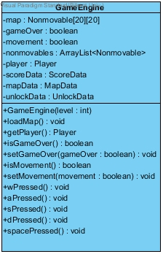
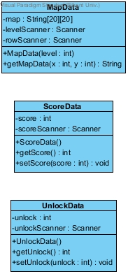
Class Diagrams-cont

Slide 9
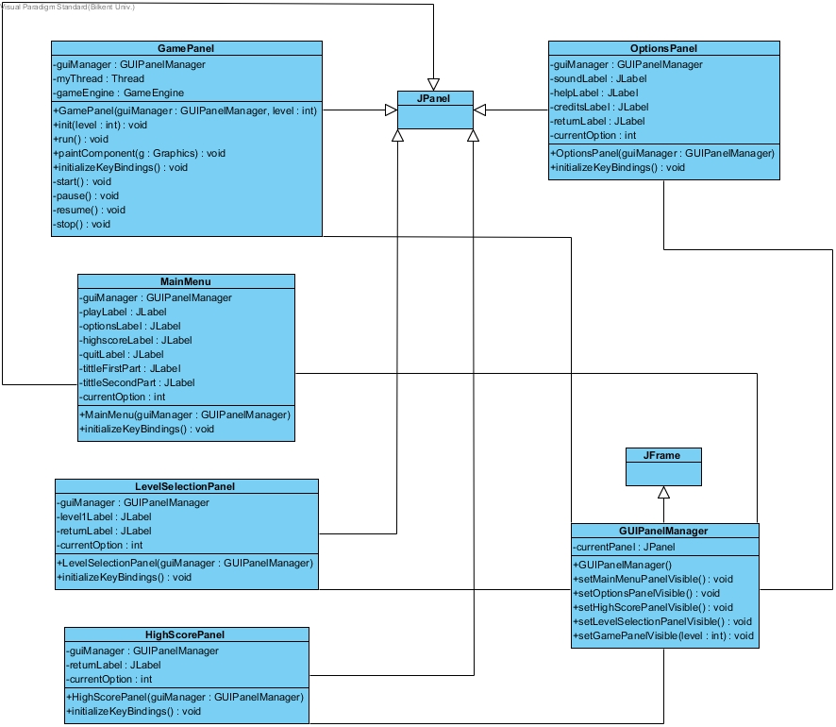
Class Diagrams-cont

Slide 10
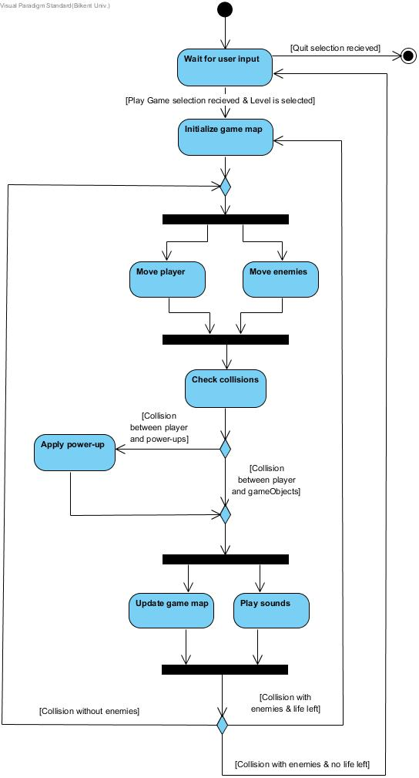
Activity Diagram

